Slide 1
Functions and an Introduction to Recursion
Chapter 6 of C++ How to Program, 9/e
©1992-2017 by Pearson Education, Inc. All Rights Reserved.

Slide 2
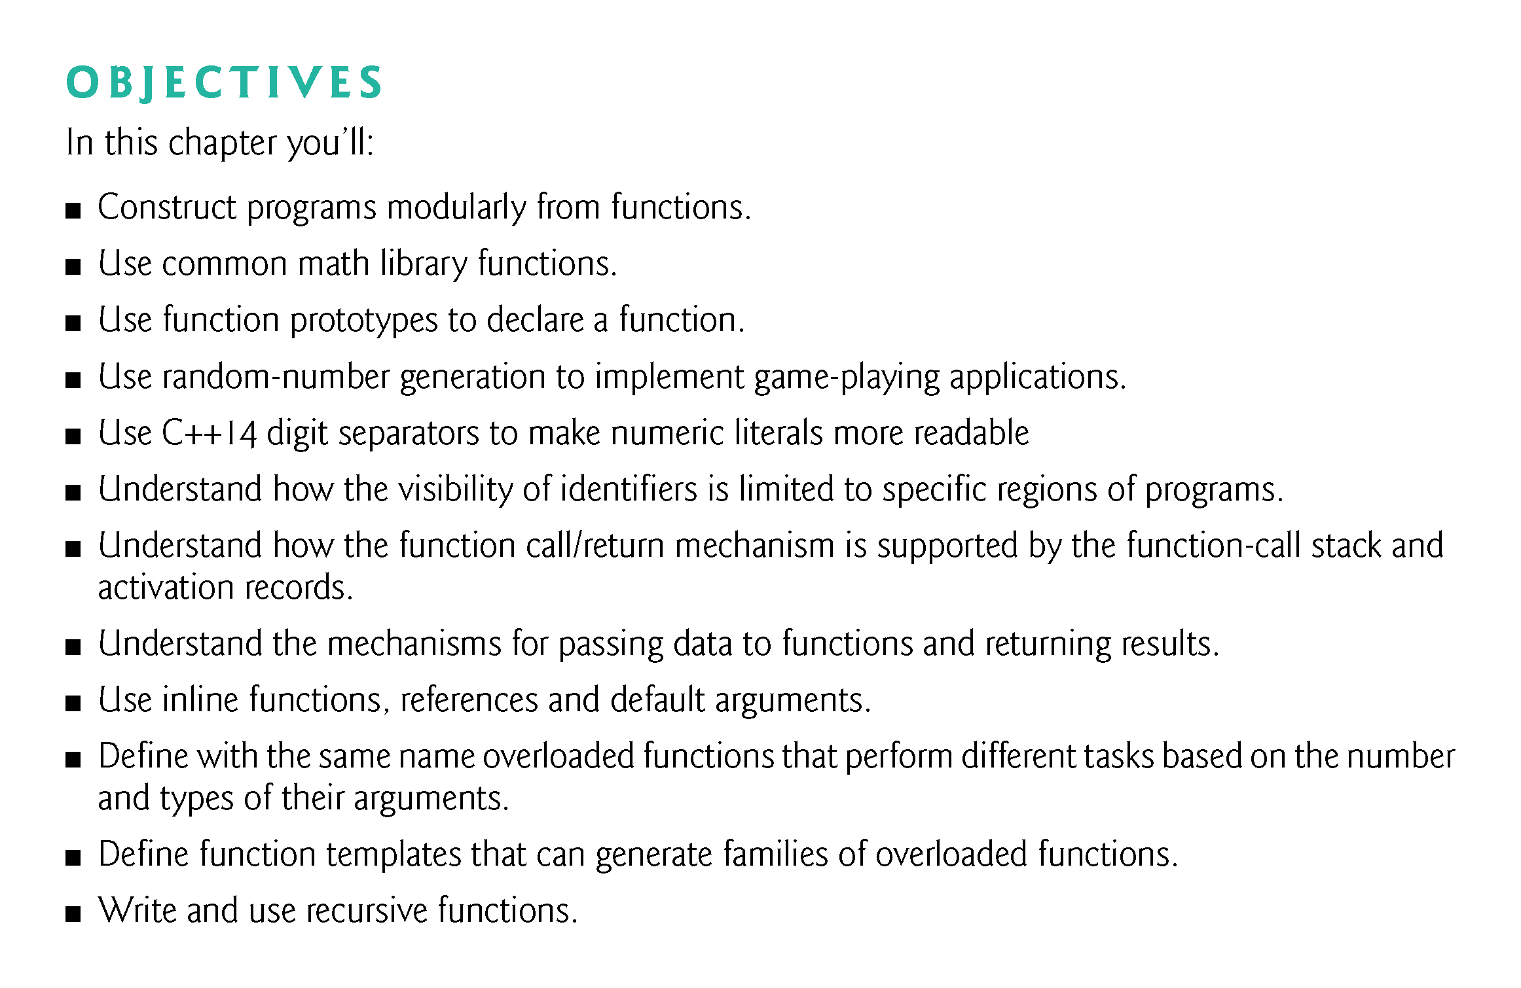
©1992-2017 by Pearson Education, Inc. All Rights Reserved.

Slide 3
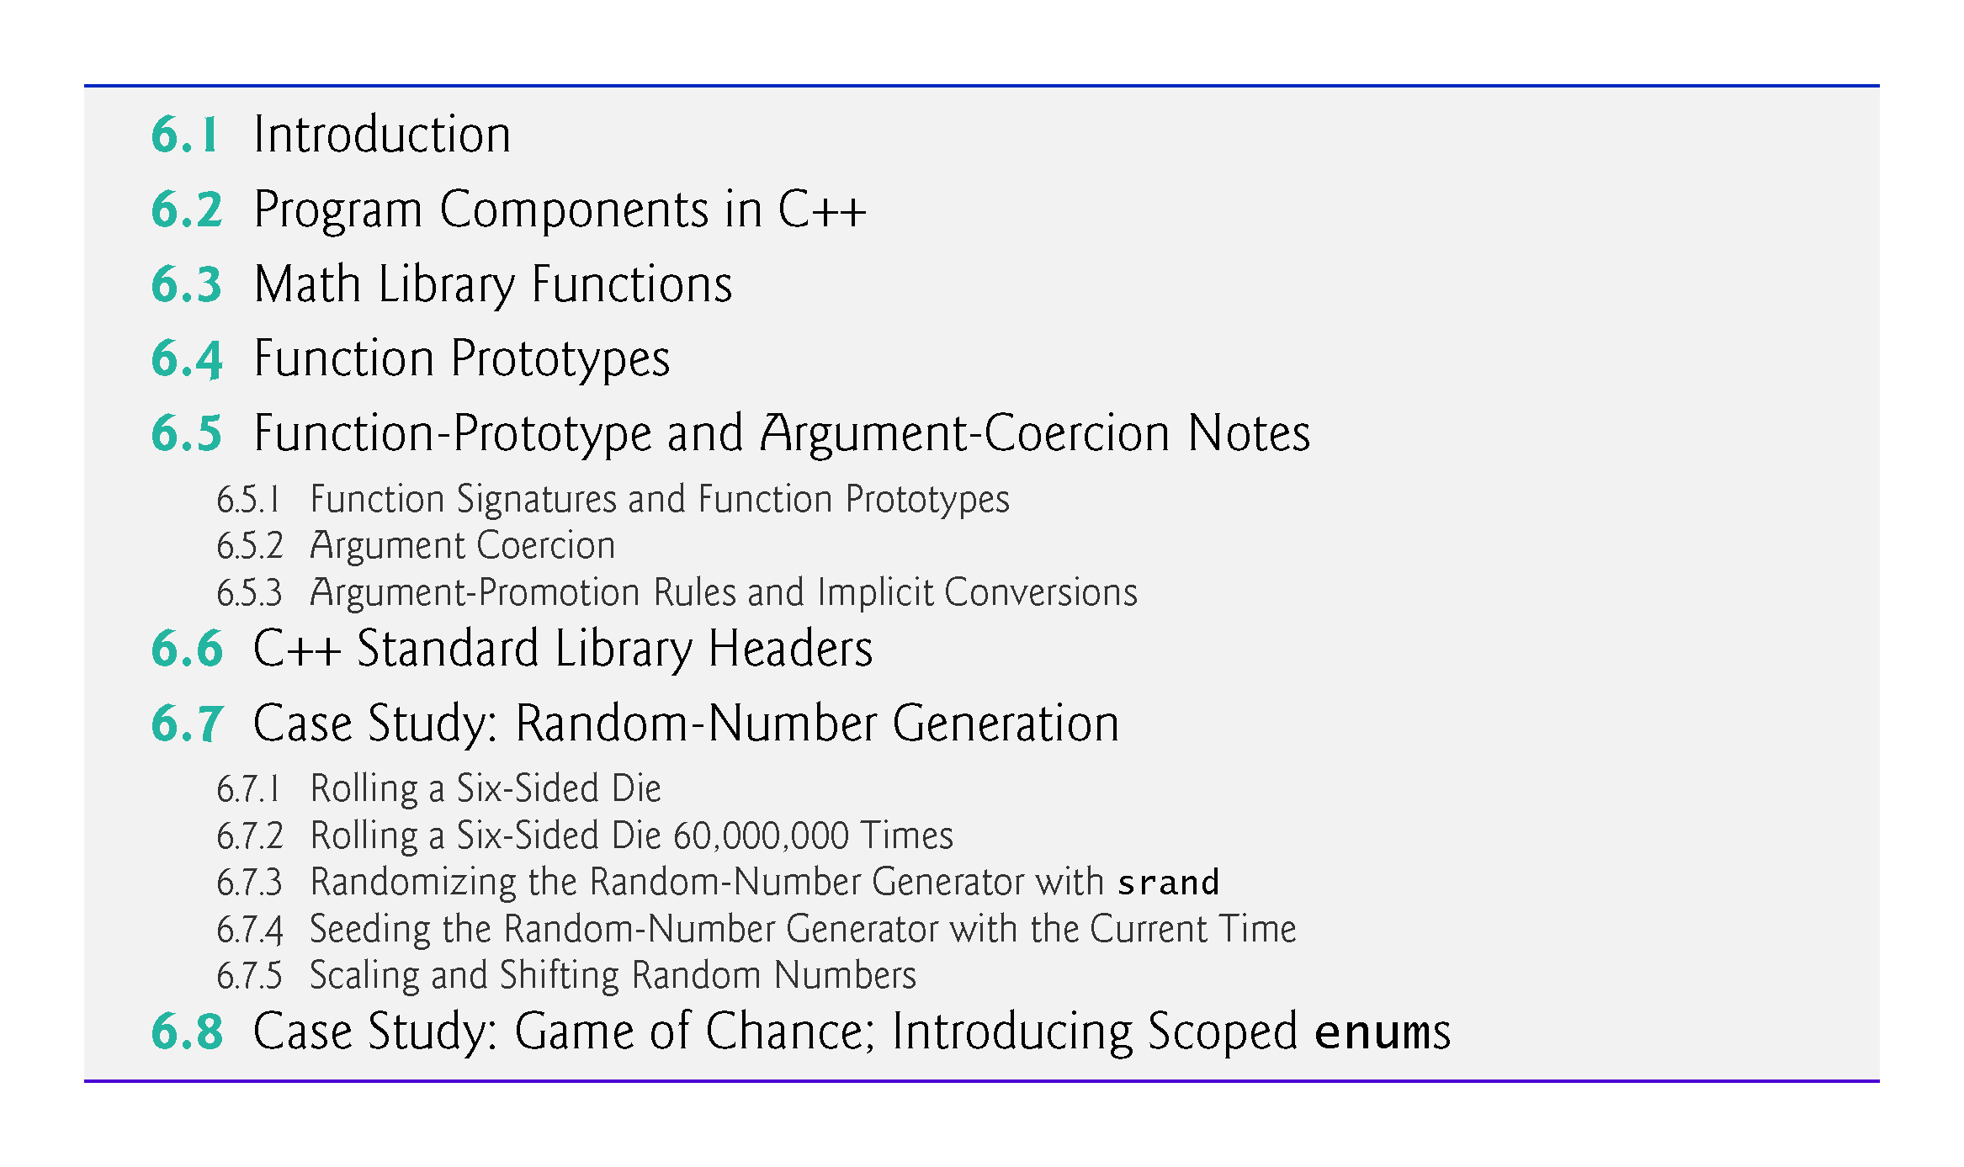
©1992-2017 by Pearson Education, Inc. All Rights Reserved.

Slide 4
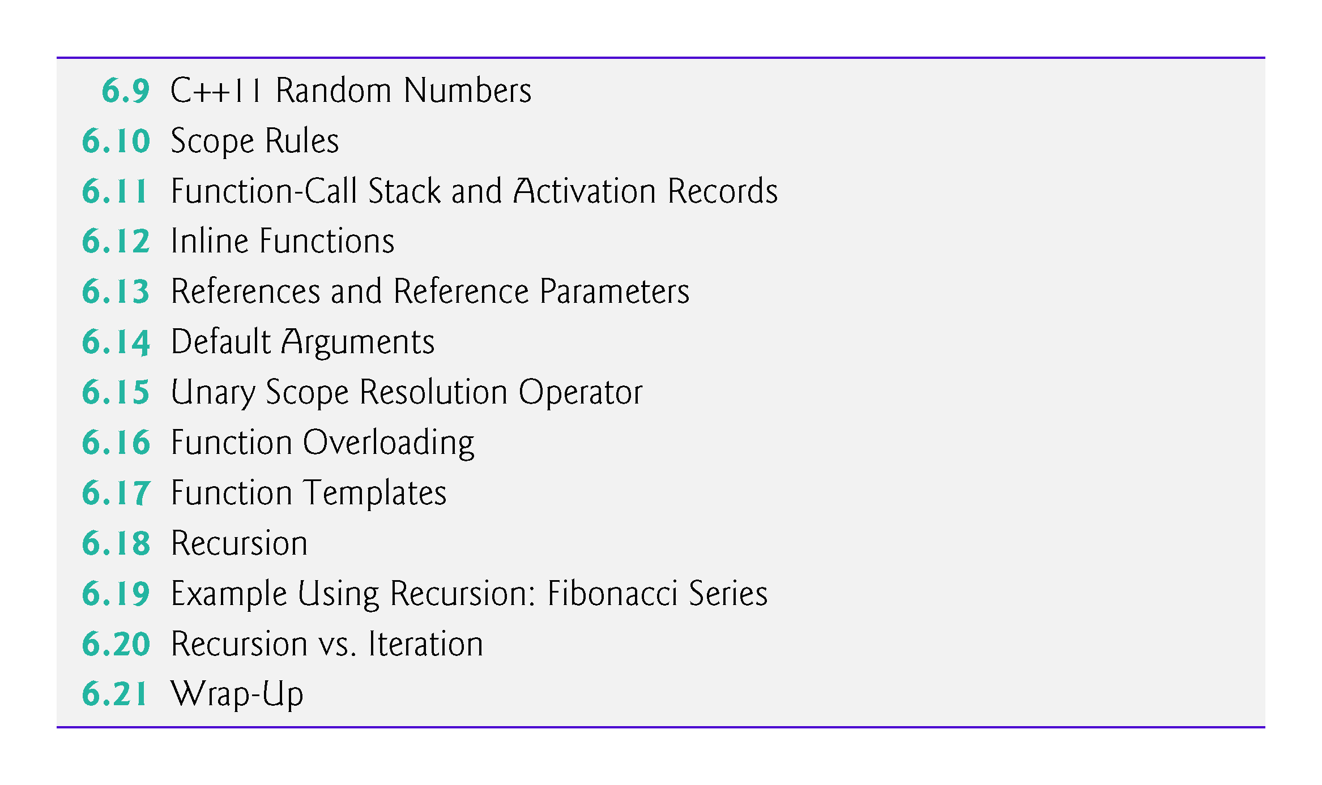
©1992-2017 by Pearson Education, Inc. All Rights Reserved.

Slide 5
6.18 Recursion
A recursive function is a function that calls itself, either directly, or indirectly (through another function).
Recursive problem-solving approaches have a number of elements in common.
A recursive function is called to solve a problem.
The function actually knows how to solve only the simplest case(s), or so-called base case(s).
If the function is called with a base case, the function simply returns a result.
If the function is called with a more complex problem, it typically divides the problem into two conceptual pieces—a piece that the function knows how to do and a piece that it does not know how to do.
This new problem looks like the original, so the function calls a copy of itself to work on the smaller problem—this is referred to as a recursive call and is also called the recursion step.
©1992-2017 by Pearson Education, Inc. All Rights Reserved.

Slide 6
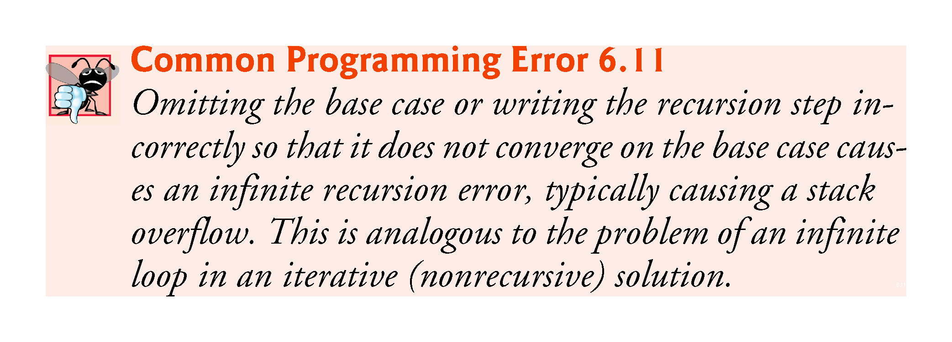
©1992-2017 by Pearson Education, Inc. All Rights Reserved.

Slide 7
6.18 Recursion (cont.)
The recursion step often includes the key-word return, because its result will be combined with the portion of the problem the function knew how to solve to form the result passed back to the original caller, possibly main.
The recursion step executes while the original call to the function is still “open,” i.e., it has not yet finished executing.
The recursion step can result in many more such recursive calls.
©1992-2017 by Pearson Education, Inc. All Rights Reserved.

Slide 8
6.18 Recursion (cont.)
Factorial
The factorial of a nonnegative integer n, written n! (and pronounced “n factorial”), is the product
n · (n – 1) · (n – 2) · … · 1
with 1! equal to 1, and 0! defined to be 1.
©1992-2017 by Pearson Education, Inc. All Rights Reserved.

Slide 9
6.18 Recursion (cont.)
Iterative Factorial
The factorial of an integer, number, greater than or equal to 0, can be calculated iteratively (nonrecursively) by using a loop.
Recursive Factorial
A recursive definition of the factorial function is arrived at by observing the following algebraic relationship:
n! = n · (n – 1)!
©1992-2017 by Pearson Education, Inc. All Rights Reserved.

Slide 10
6.18 Recursion (cont.)
Evaluating 5!
The evaluation of 5! would proceed as shown in Fig. 6.24, which illustrates how the succession of recursive calls proceeds until 1! is evaluated to be 1, terminating the recursion.
Figure 6.24(b) shows the values returned from each recursive call to its caller until the final value is calculated and returned.
©1992-2017 by Pearson Education, Inc. All Rights Reserved.

Slide 11
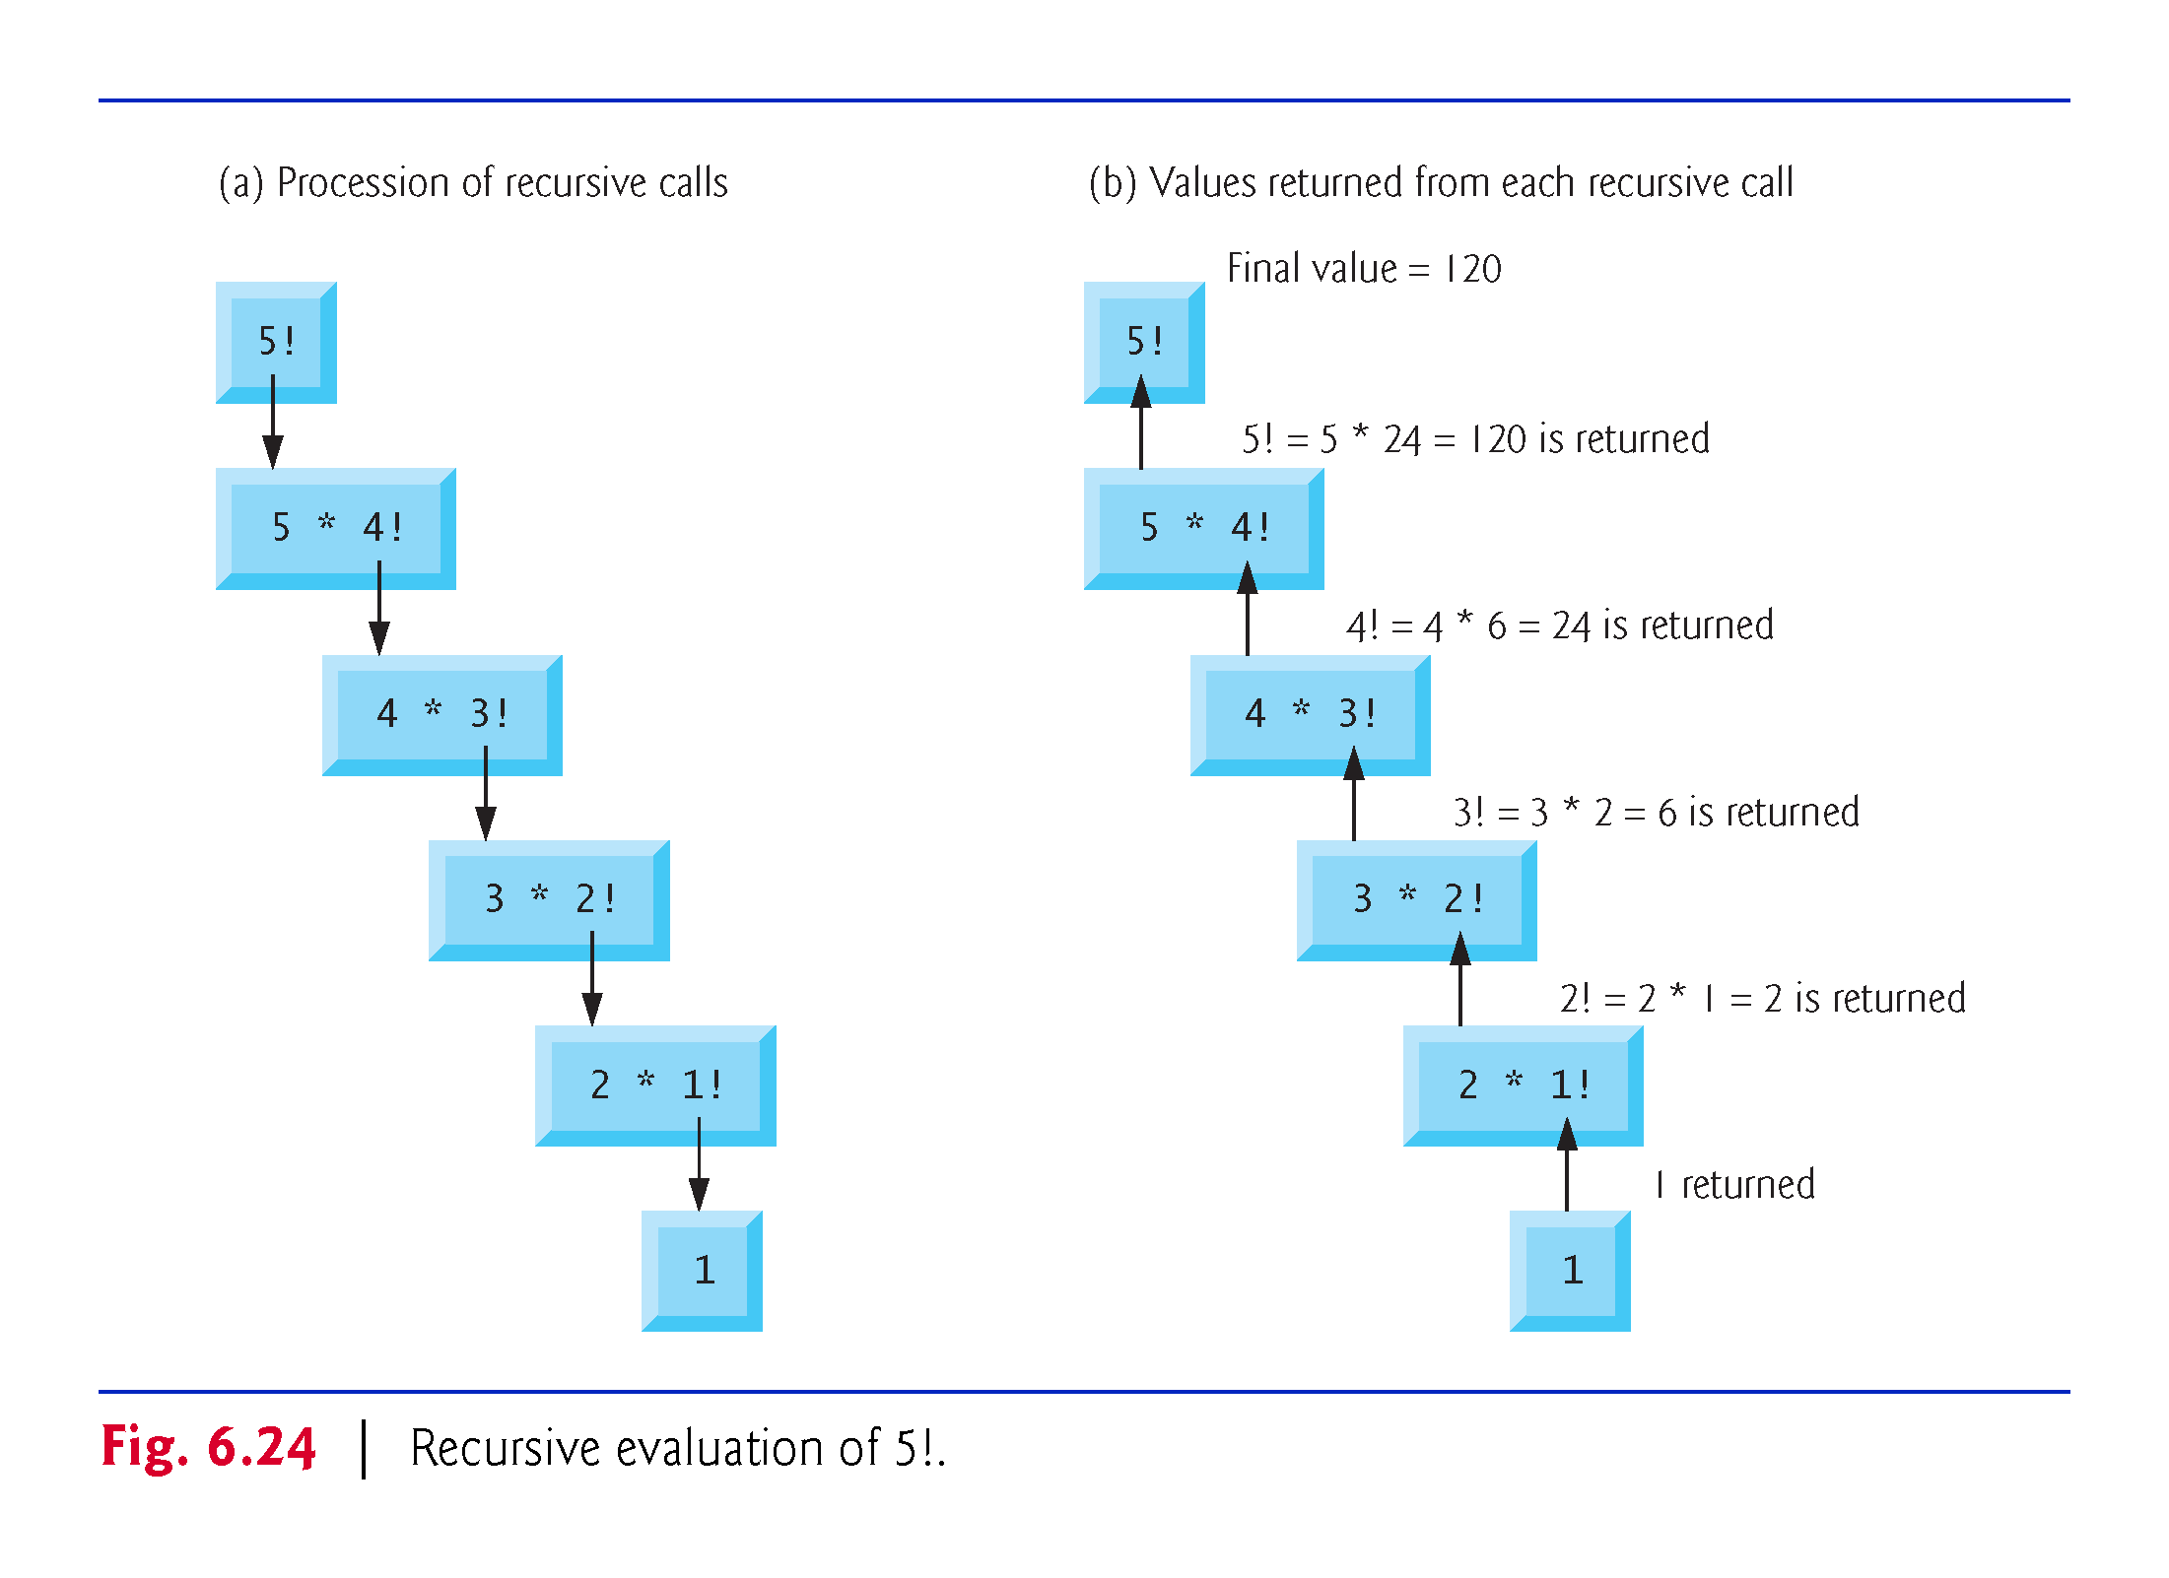
©1992-2017 by Pearson Education, Inc. All Rights Reserved.

Slide 12
6.18 Recursion (cont.)
Using a Recursive factorial Function to Calculate Factorials
Figure 6.25 uses recursion to calculate and print the factorials of the integers 0–10.
©1992-2017 by Pearson Education, Inc. All Rights Reserved.

Slide 13
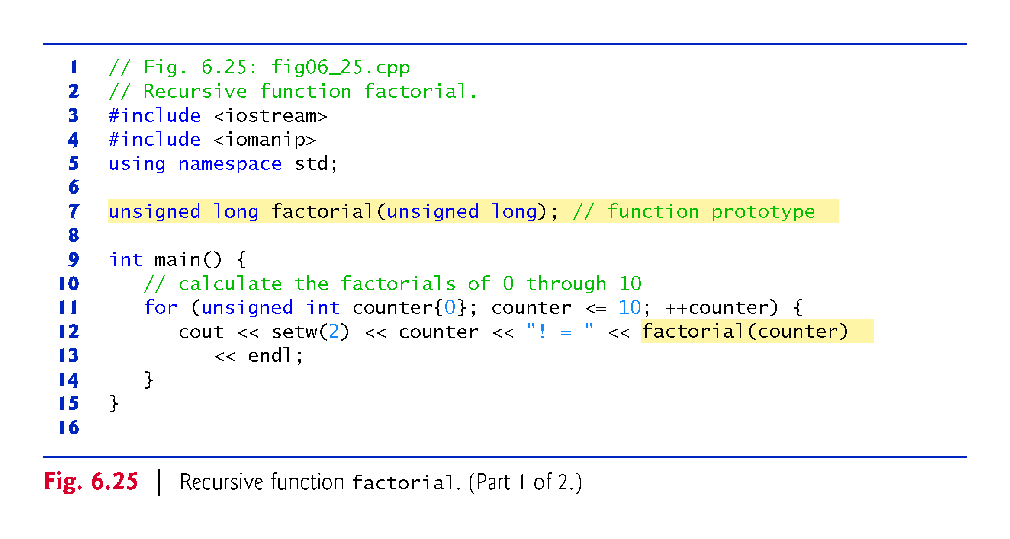
©1992-2017 by Pearson Education, Inc. All Rights Reserved.

Slide 14
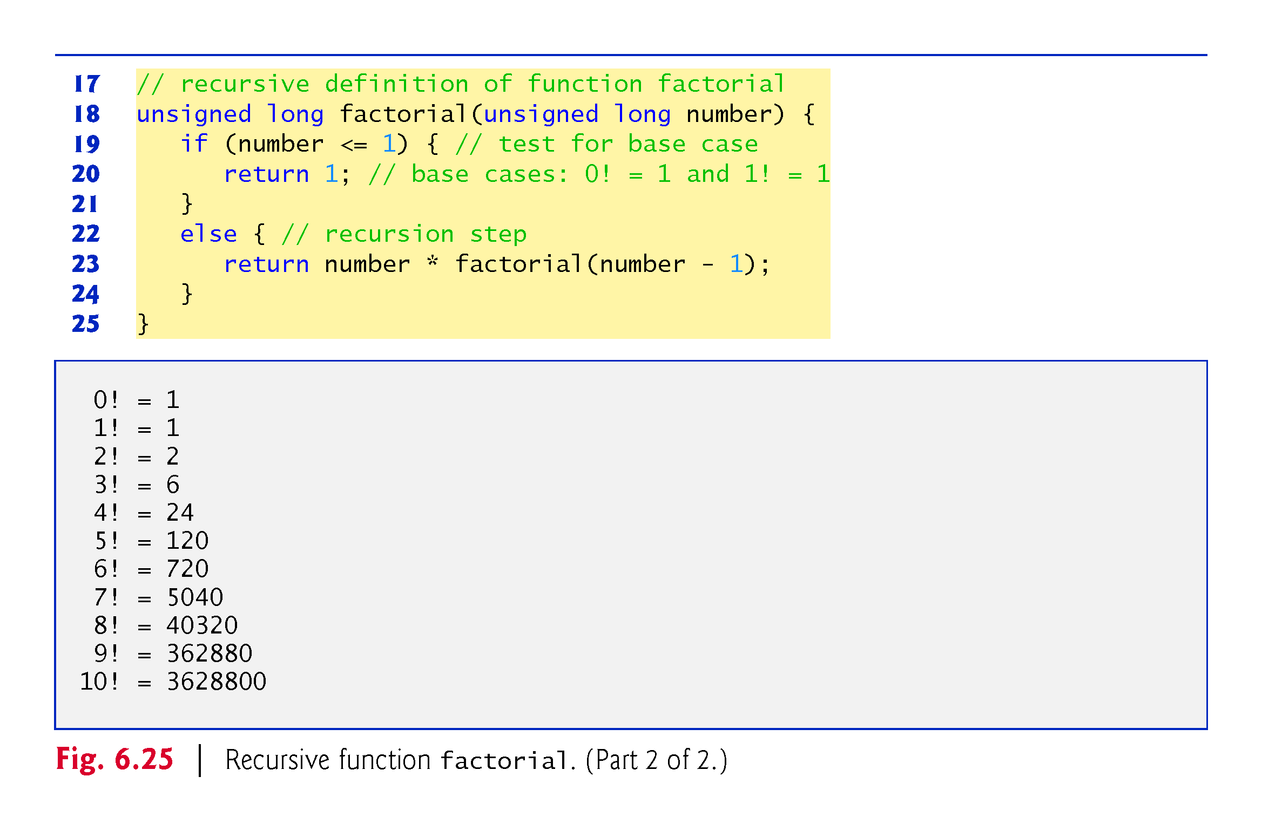
©1992-2017 by Pearson Education, Inc. All Rights Reserved.

Slide 15
6.18 Recursion (cont.)
C++11 Type unsigned long long int
C++11’s unsigned long long int type (which can be abbreviated as unsigned long long ) on some systems enables you to store values in at least 8 bytes (64 bits) which can hold numbers as large as 18,446,744,073,709,551,615.
©1992-2017 by Pearson Education, Inc. All Rights Reserved.

Slide 16
6.19 Example Using Recursion: Fibonacci Series
The Fibonacci series
0, 1, 1, 2, 3, 5, 8, 13, 21, …
begins with 0 and 1 and has the property that each subsequent Fibonacci number is the sum of the previous two Fibonacci numbers.
The series occurs in nature and, in particular, describes a form of spiral.
The ratio of successive Fibonacci numbers converges on a constant value of 1.618….
This frequently occurs in nature and has been called the golden ratio or the golden mean.
Humans tend to find the golden mean aesthetically pleasing.
©1992-2017 by Pearson Education, Inc. All Rights Reserved.

Slide 17
6.19 Example Using Recursion: Fibonacci Series (cont.)
Recursive Fibonacci Definition
The Fibonacci series can be defined recursively as follows:
fibonacci(0) = 0 fibonacci(1) = 1 fibonacci(n) = fibonacci(n – 1) + fibonacci(n – 2)
The program of Fig. 6.26 calculates the nth Fibonacci number recursively by using function fibonacci.
©1992-2017 by Pearson Education, Inc. All Rights Reserved.

Slide 18
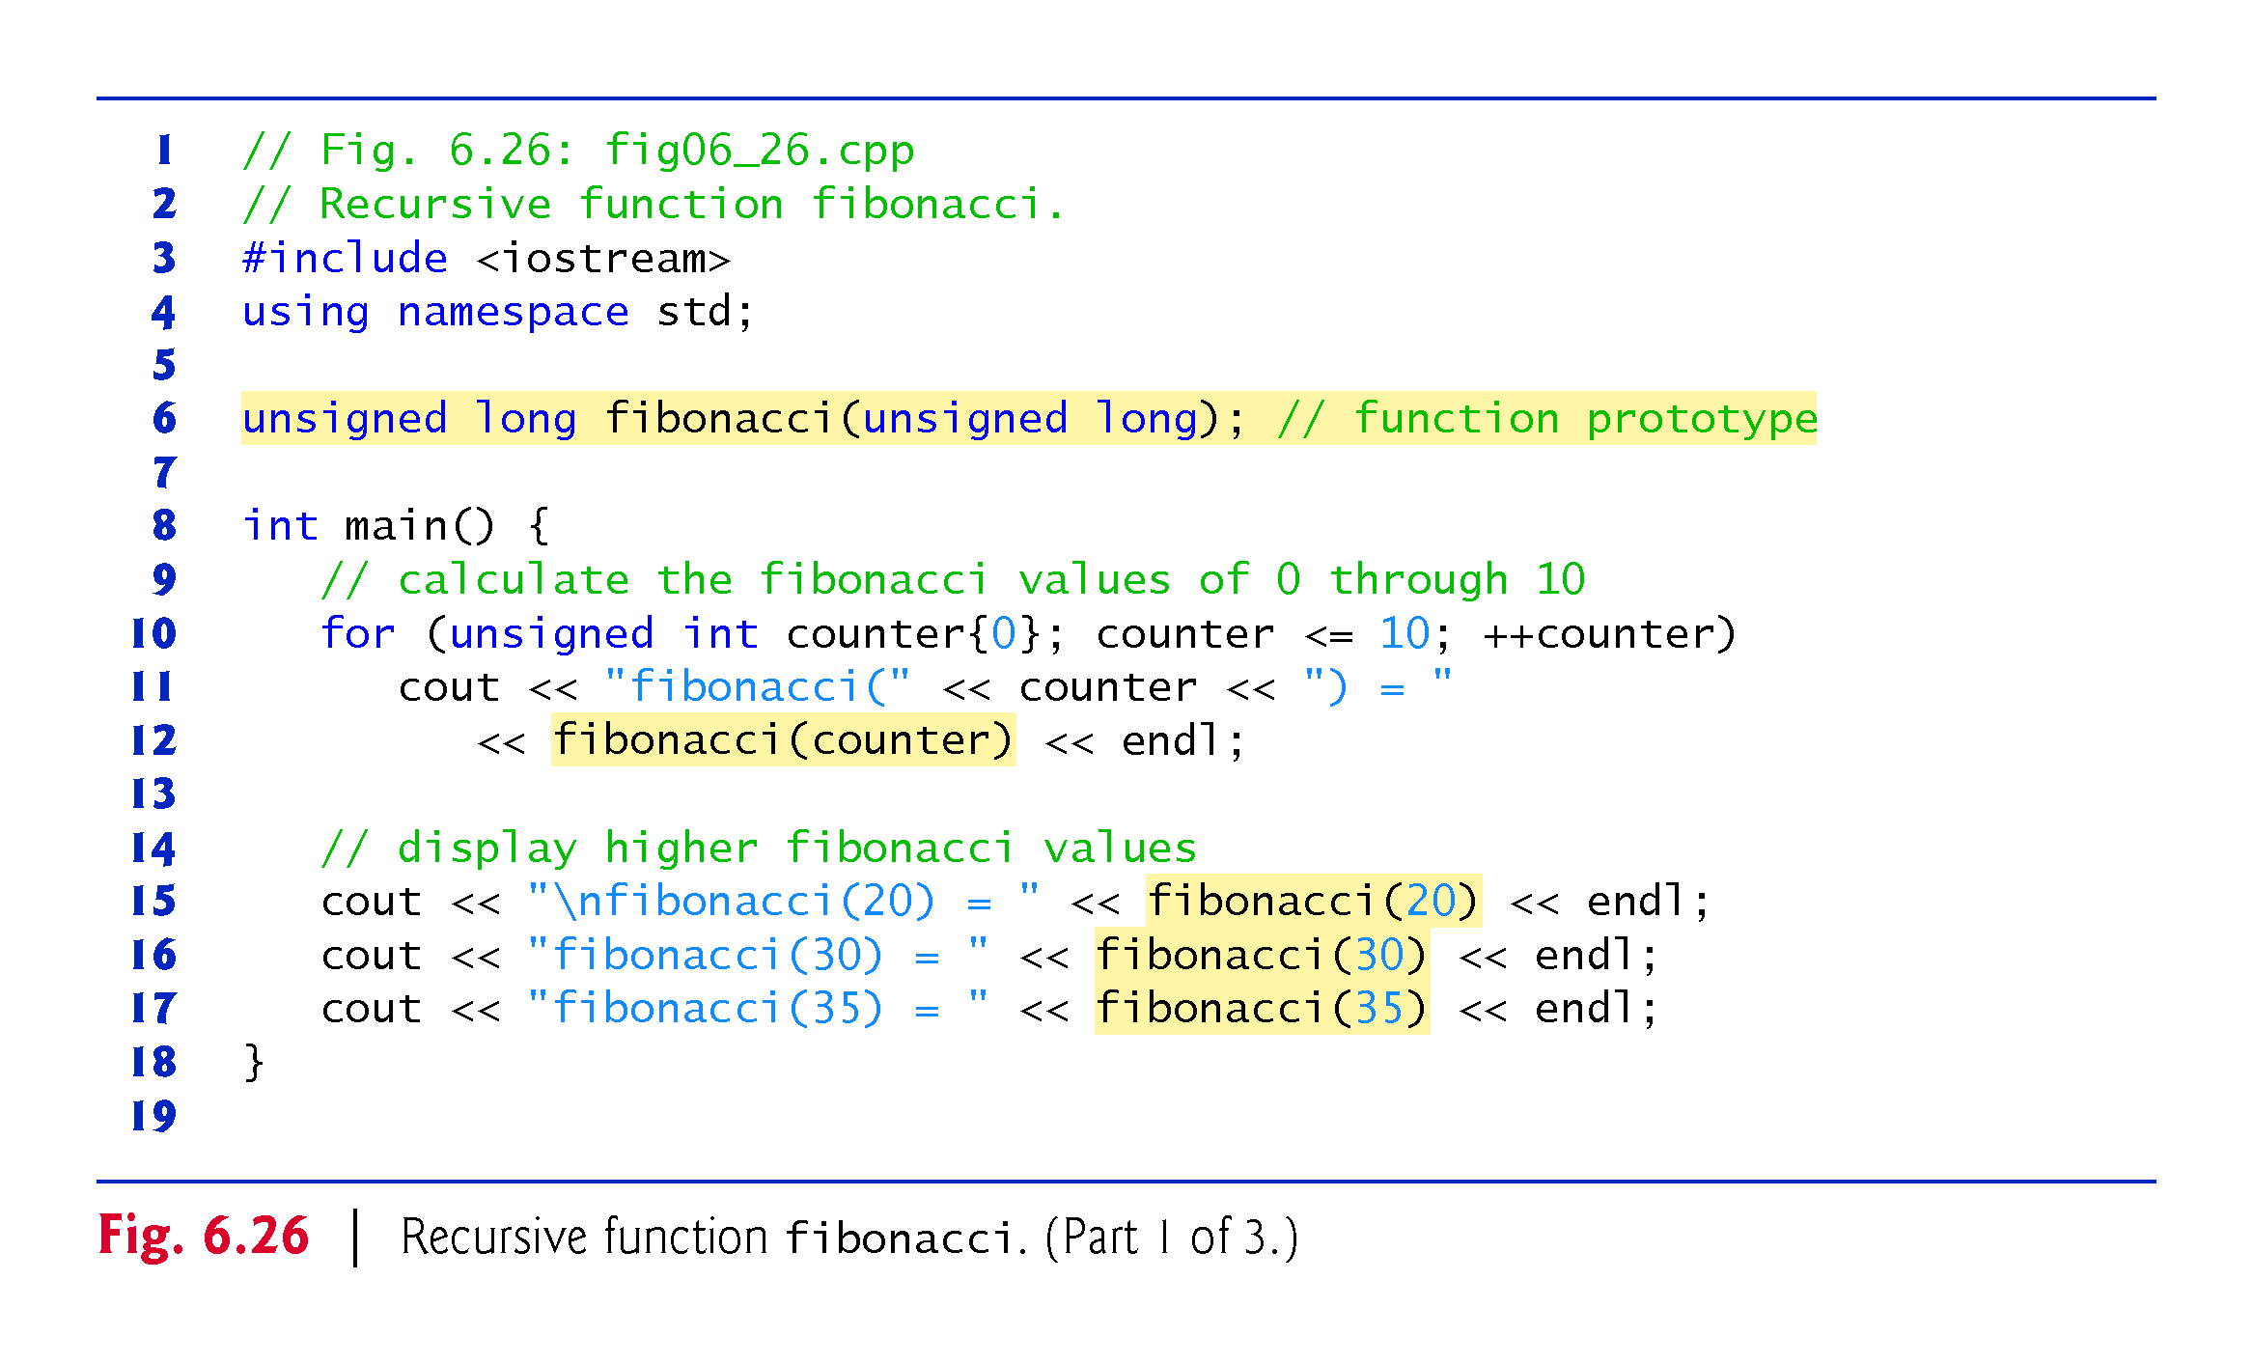
©1992-2017 by Pearson Education, Inc. All Rights Reserved.

Slide 19
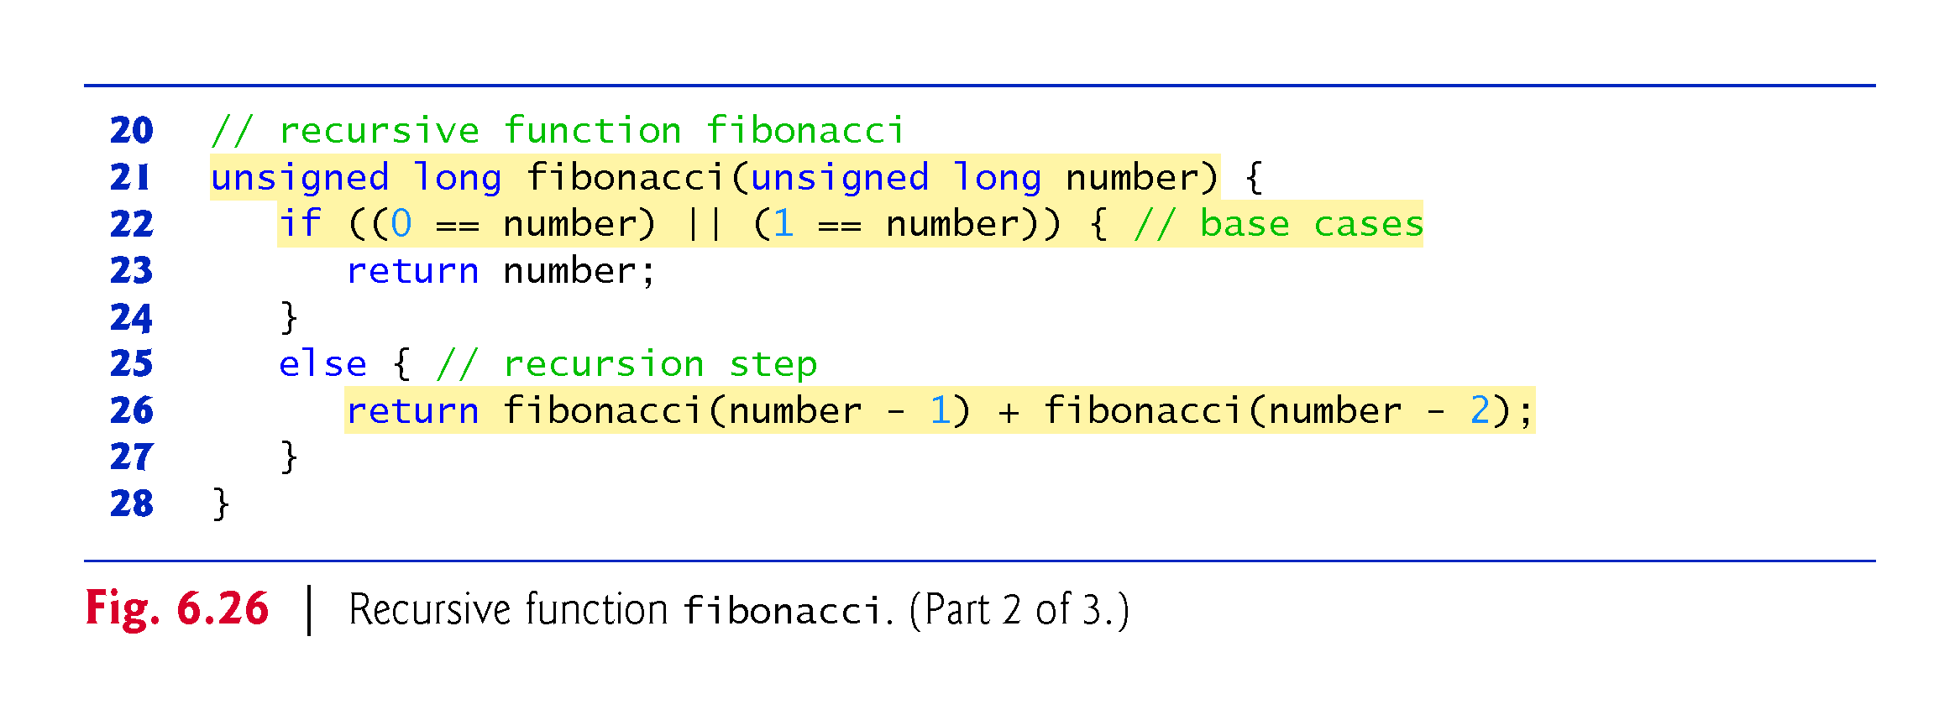
©1992-2017 by Pearson Education, Inc. All Rights Reserved.

Slide 20
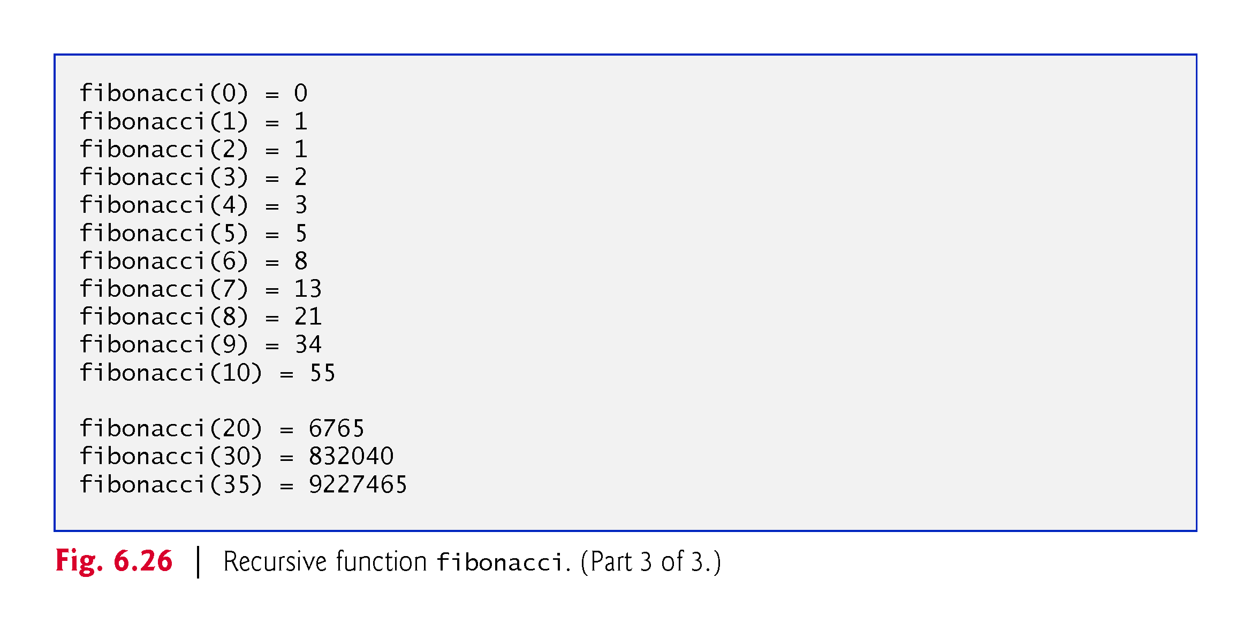
©1992-2017 by Pearson Education, Inc. All Rights Reserved.

Slide 21
6.19 Example Using Recursion: Fibonacci Series (cont.)
Figure 6.27 shows how function fibonacci would evaluate fibonacci(3).
Figure raises interesting issues about the order in which C++ compilers evaluate the operands of operators.
Separate issue from the order in which operators are applied to their operands, namely, the order dictated by the rules of operator precedence and associativity.
Most programmers assume that operands are evaluated left to right.
C++ does not specify the order in which the operands of most operators (including +) are to be evaluated.
Therefore, you must make no assumption about the order in which these calls execute.
©1992-2017 by Pearson Education, Inc. All Rights Reserved.

Slide 22
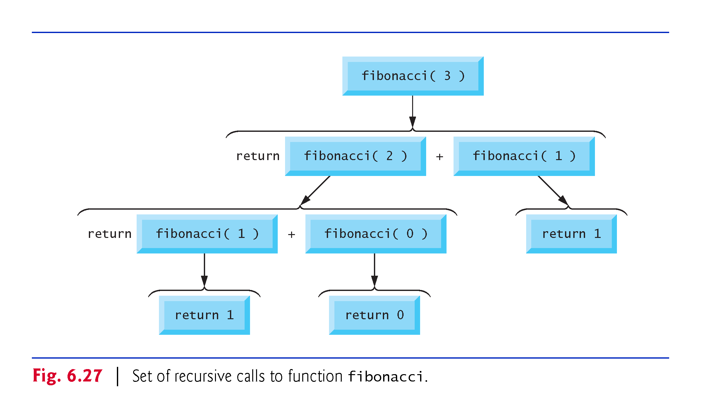
©1992-2017 by Pearson Education, Inc. All Rights Reserved.

Slide 23
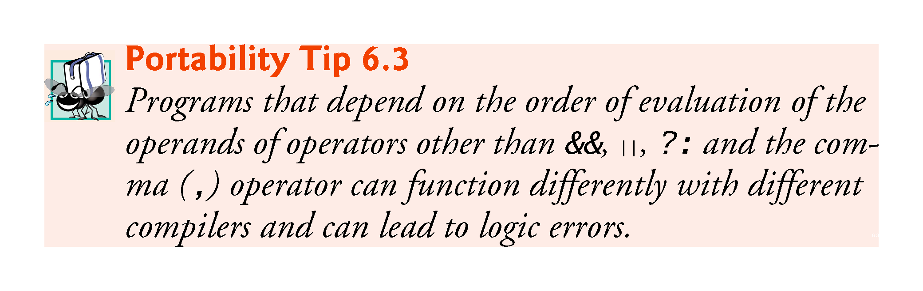
©1992-2017 by Pearson Education, Inc. All Rights Reserved.

Slide 24
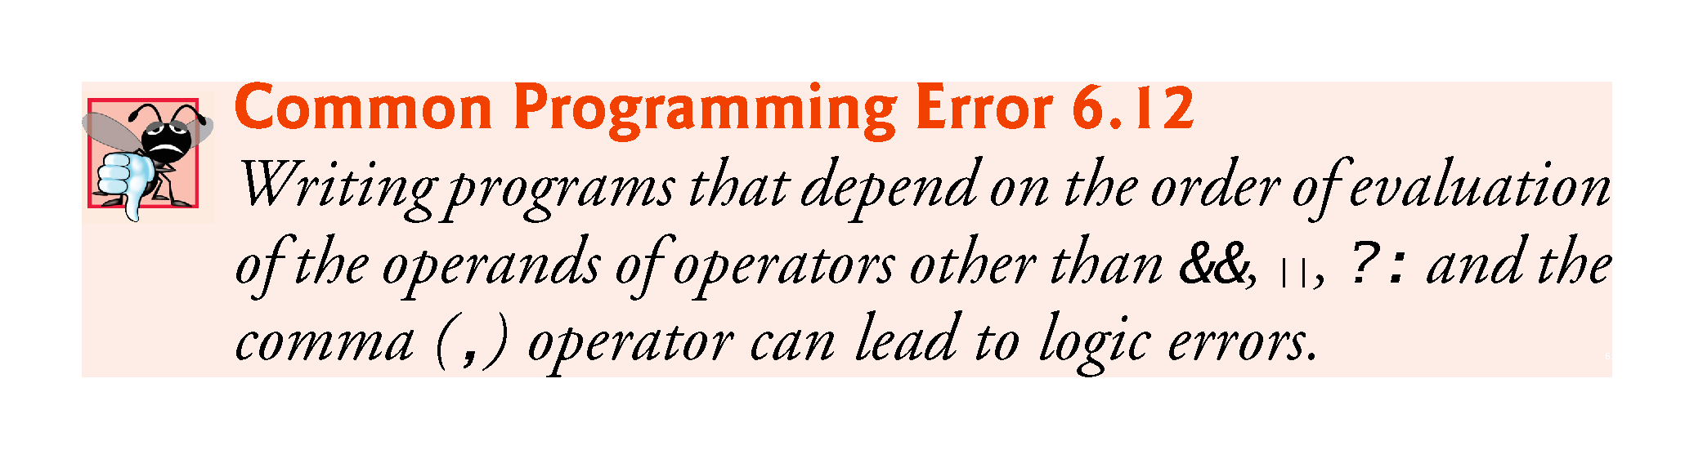
©1992-2017 by Pearson Education, Inc. All Rights Reserved.

Slide 25
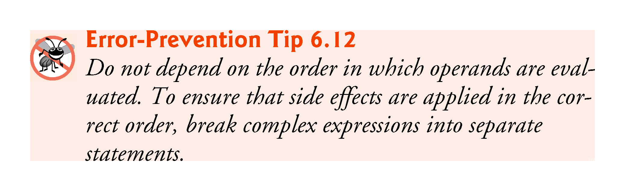
©1992-2017 by Pearson Education, Inc. All Rights Reserved.

Slide 26
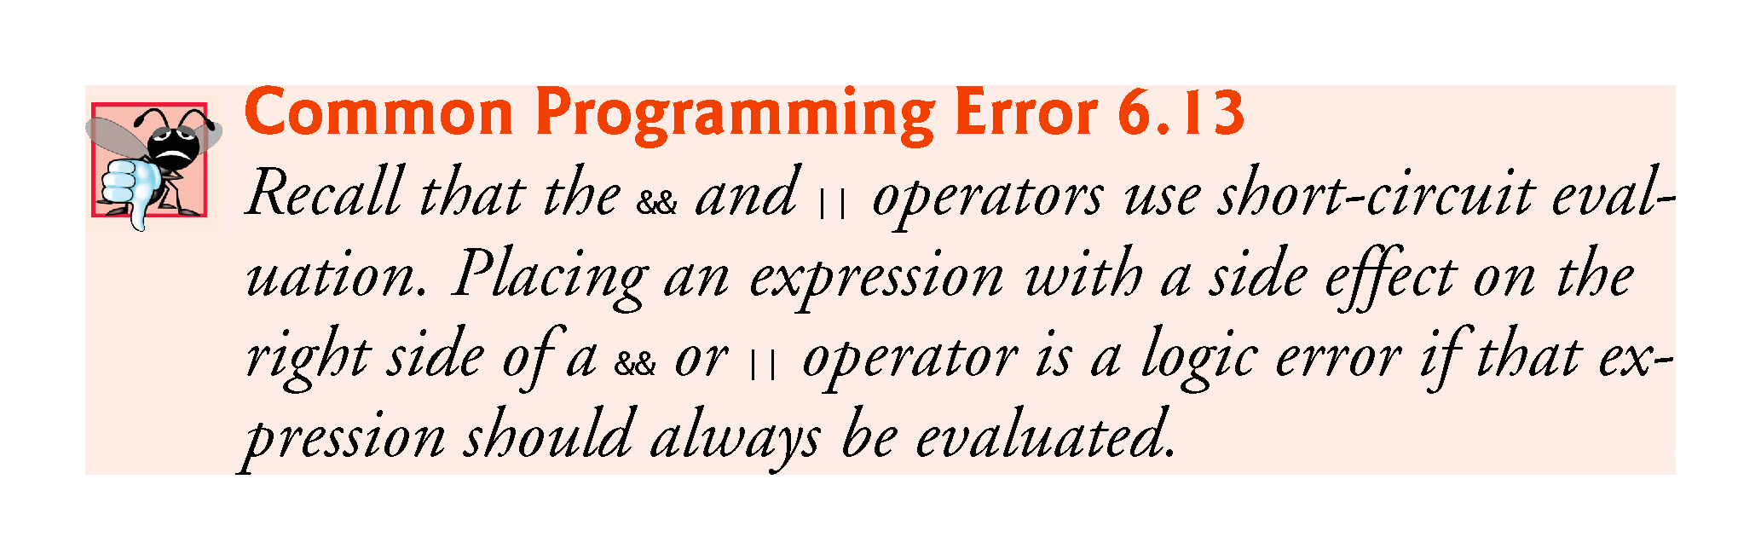
©1992-2017 by Pearson Education, Inc. All Rights Reserved.

Slide 27
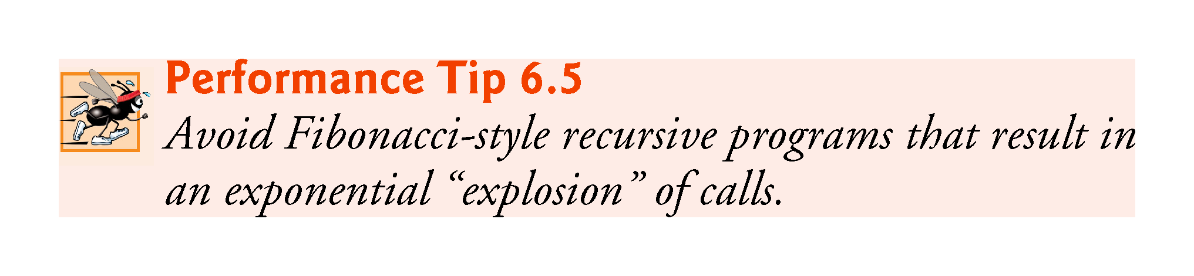
©1992-2017 by Pearson Education, Inc. All Rights Reserved.

Slide 28
6.20 Recursion vs. Iteration
Both iteration and recursion are based on a control statement:
Iteration uses an iteration statement
Recursion uses a selection statement.
Both iteration and recursion involve iteration:
Iteration explicitly uses an iteration statement
Recursion achieves repetition through repeated function calls.
Iteration and recursion each involve a termination test:
Iteration terminates when the loop-continuation condition fails
Recursion terminates when a base case is recognized.
©1992-2017 by Pearson Education, Inc. All Rights Reserved.

Slide 29
6.22 Recursion vs. Iteration (cont.)
Counter-controlled iteration and recursion both gradually approach termination:
Iteration modifies a counter until the counter assumes a value that makes the loop-continuation condition fail
Recursion produces simpler versions of the original problem until the base case is reached.
Both iteration and recursion can occur infinitely:
An infinite loop occurs with iteration if the loop-continuation test never becomes false
Infinite recursion occurs if the recursion step does not reduce the problem during each recursive call in a manner that converges on the base case.
To illustrate the differences between iteration and recursion, Fig. 6.28 presents an iterative solution to the factorial problem.
©1992-2017 by Pearson Education, Inc. All Rights Reserved.

Slide 30
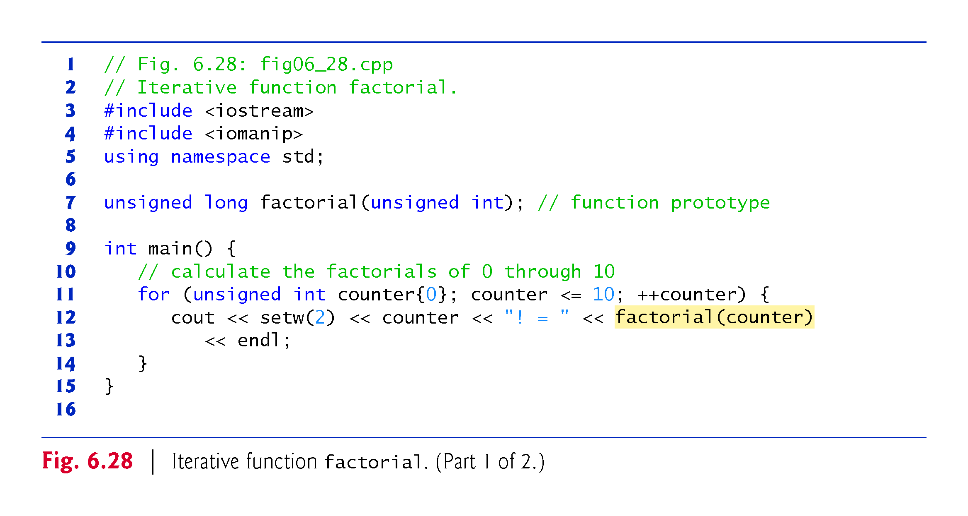
©1992-2017 by Pearson Education, Inc. All Rights Reserved.

Slide 31
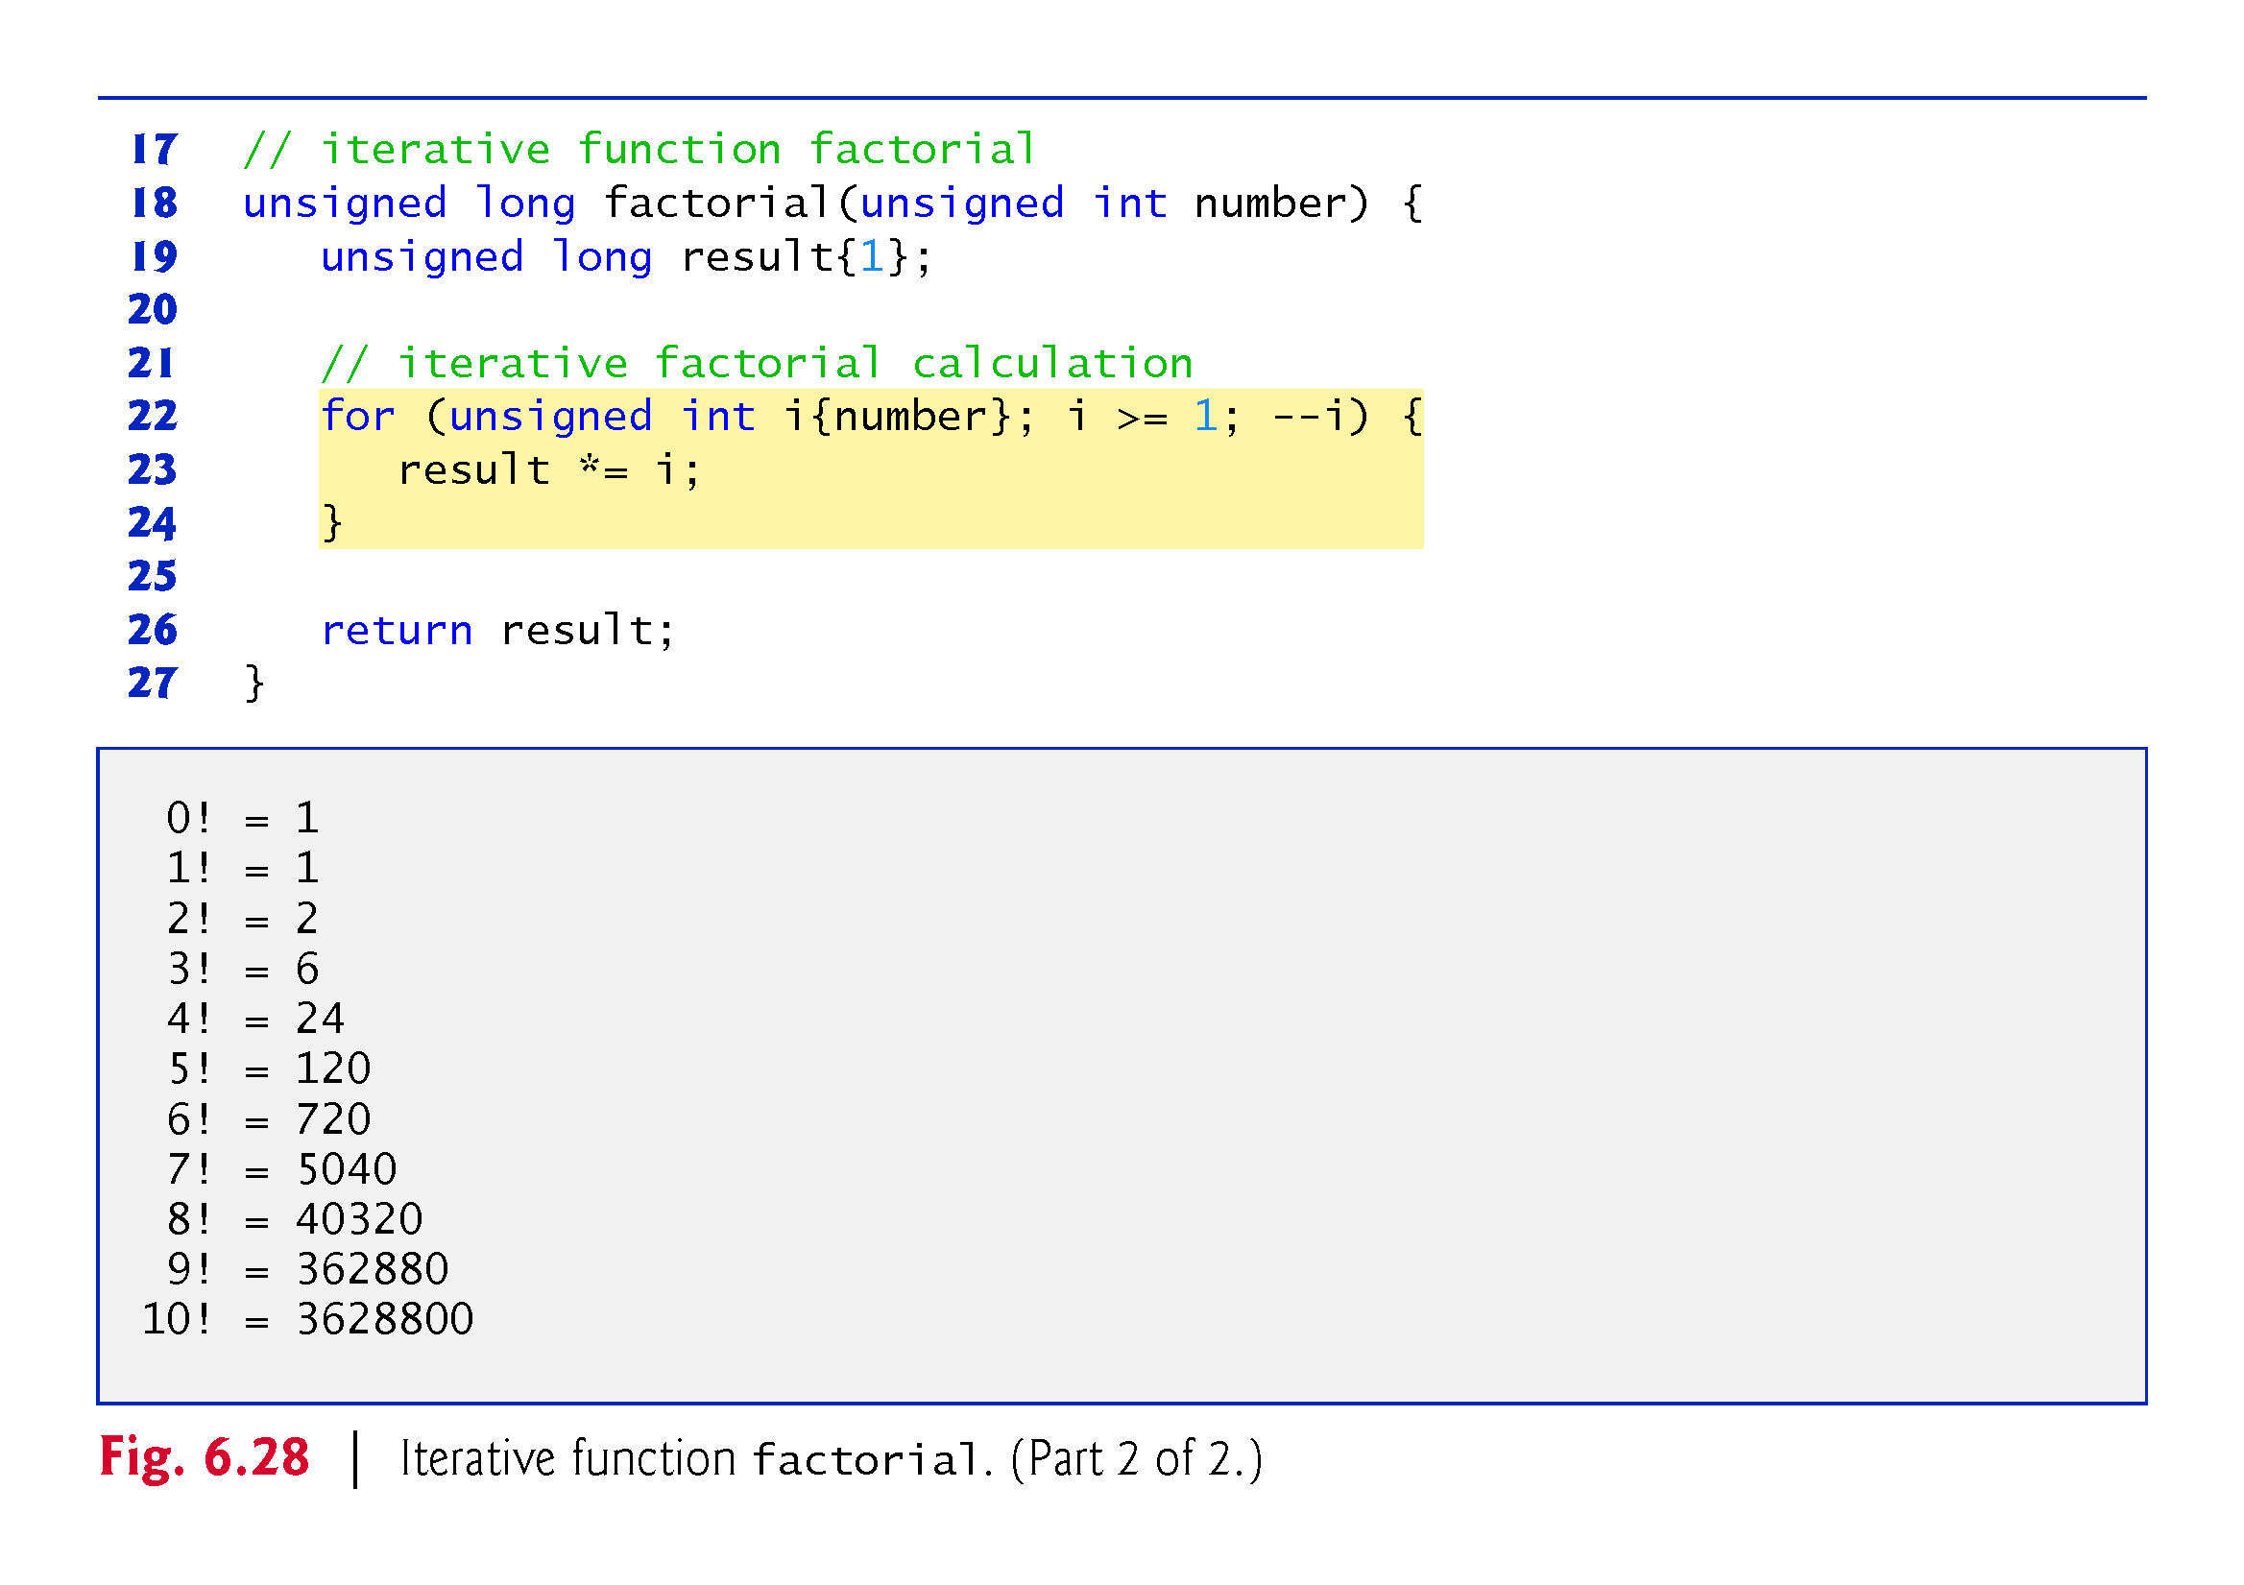
©1992-2017 by Pearson Education, Inc. All Rights Reserved.

Slide 32
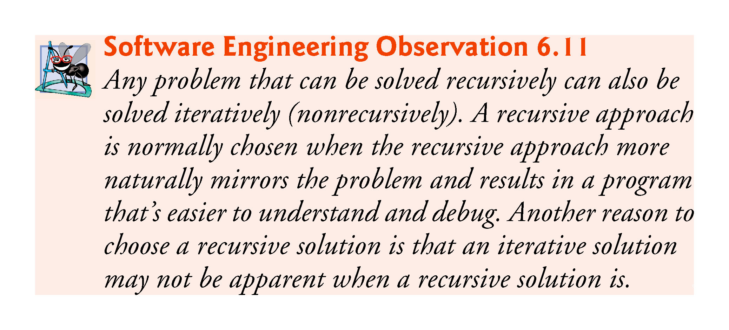
©1992-2017 by Pearson Education, Inc. All Rights Reserved.

Slide 33
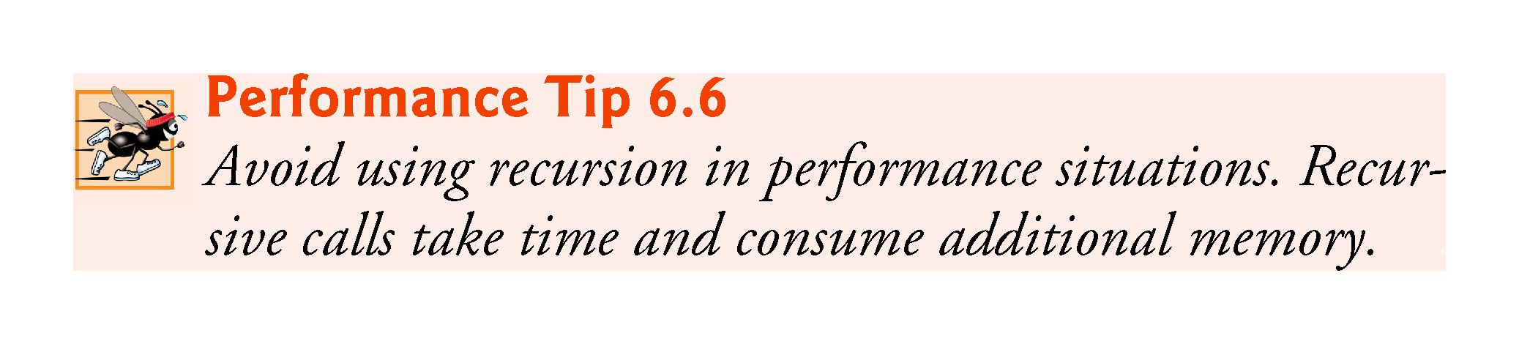
©1992-2017 by Pearson Education, Inc. All Rights Reserved.

Slide 34
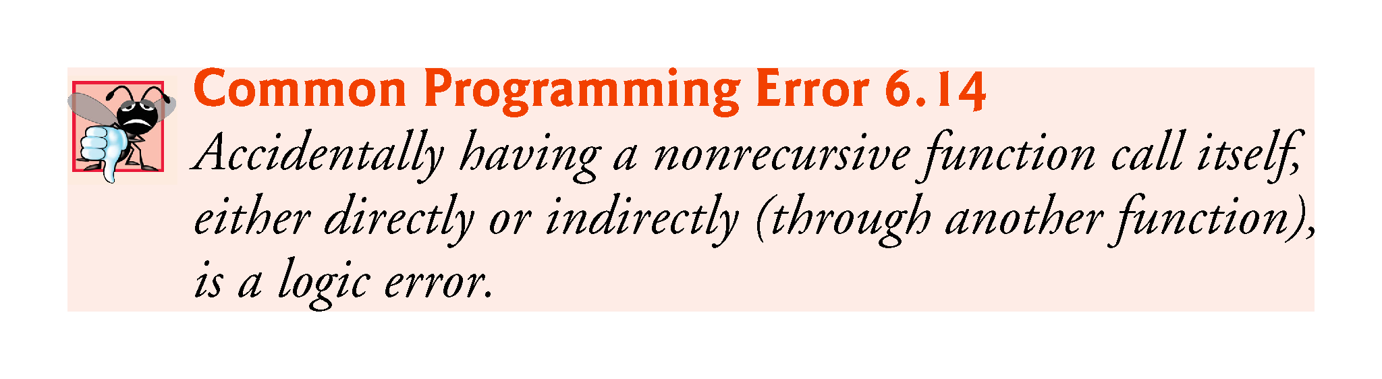
©1992-2017 by Pearson Education, Inc. All Rights Reserved.

